Slide 1





CASE STUDY
DATA MART
Presented By : Nikhil Kumar Roy

Slide 2


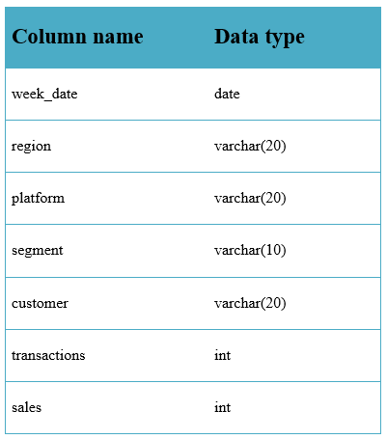

SCHEMA
Data Dart is my latest venture and I want your help to analyze the sales and performance of my venture. In June 2020 - large-scale supply changes were made at Data Mart. All Data Mart products now use sustainable packaging methods in every single step from the farm all the way to the customer.

Slide 3
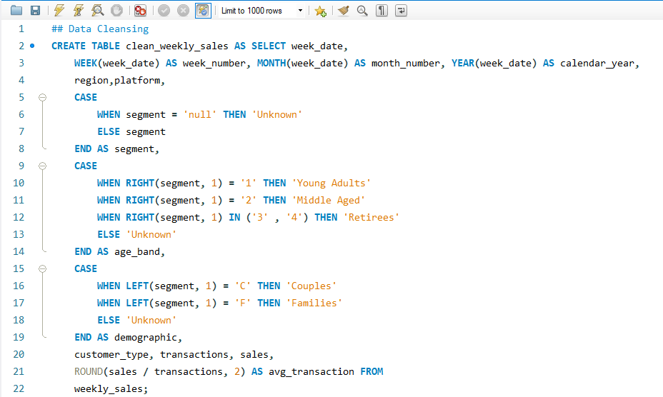

DATA CLEANSING

Slide 4
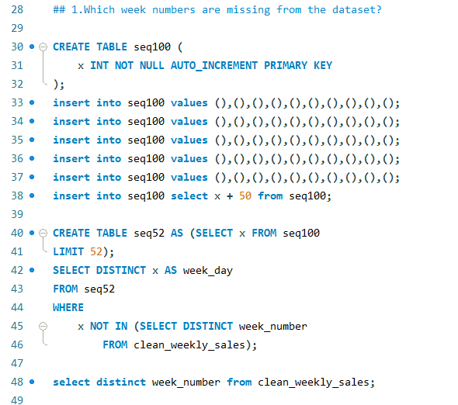
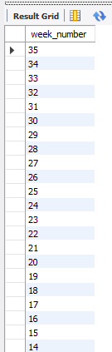
1. Which week numbers are missing from the dataset?

Slide 5

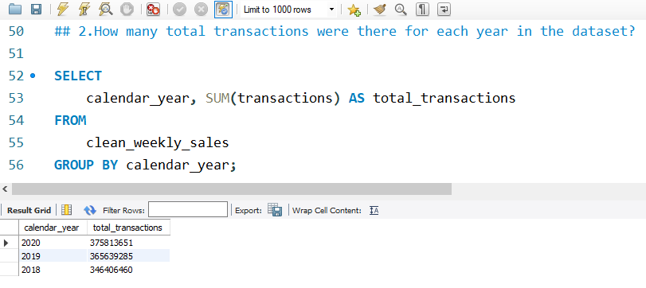

2.How many total transactions were there for each year in the dataset?

Slide 6
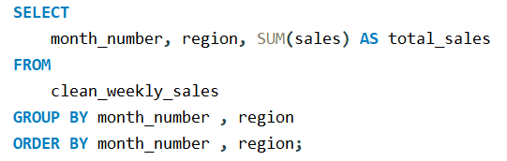
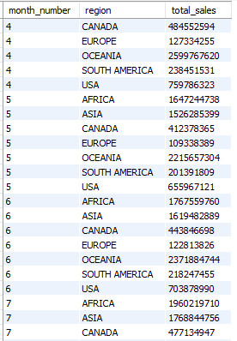


3.What are the total sales for each region for each month?

Slide 7
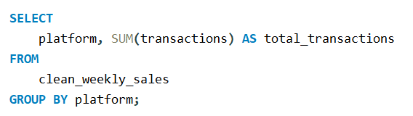


4.What is the total count of transactions for each platform

Slide 8
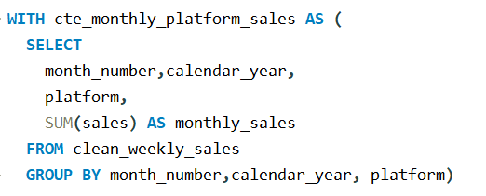
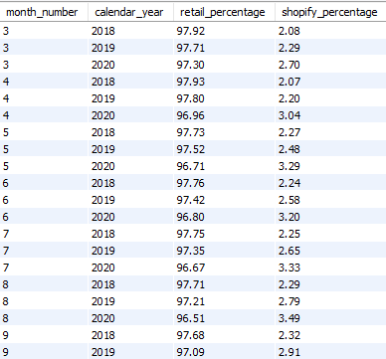
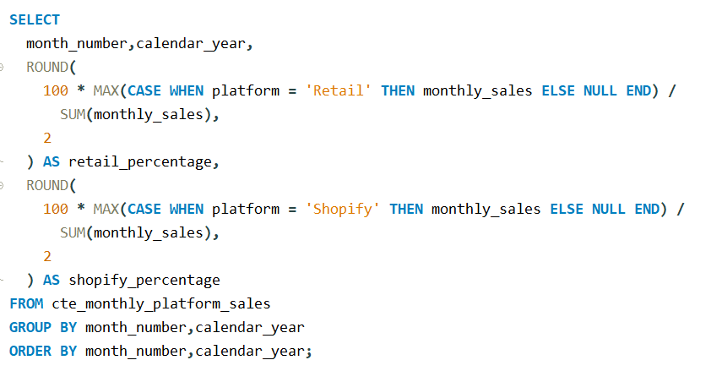

5. What is the percentage of sales for Retail vs Shopify for each month?

Slide 9
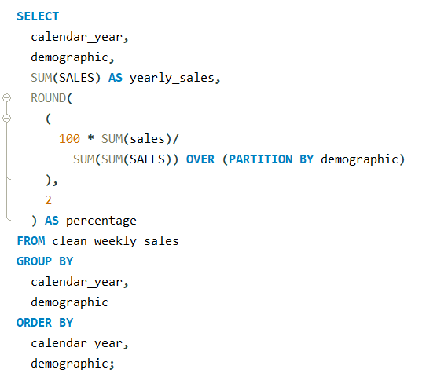
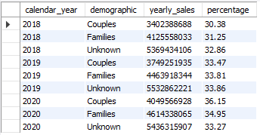

6.What is the percentage of sales by demographic for each year in the dataset?

Slide 10
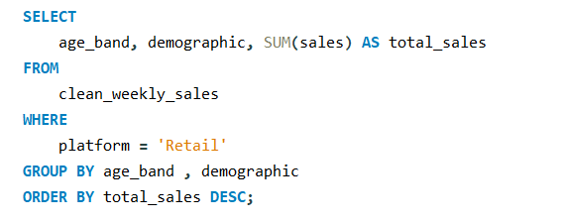

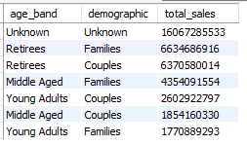
7.Which age_band and demographic values contribute the most to Retail sales?

Slide 11




THANK YOU
https://github.com/NikhilRoyDA
https://www.linkedin.com/in/nikhil-kumar-roy/
nikhilroy744@gmail.com

